Slide 1
Module 1 Data Warehouse Concepts and Architectures
Lesson 6: Data Warehouse Examples
Notes:
Welcome to Lesson 6 of Module 1 on data warehouse concepts and challenges
Previous lectures
Data warehouse characteristics and motivation
Project characteristics and business architectures for DW deployment
Maybe just show DWs in two industries and leave health care for reading.
Lesson 6 presents business aspects of data warehouses in key industries.
Opening question: Did retail DWs support analysis about beer and diapers being located together?

Slide 2
Lesson Objectives
Discuss data warehouse requirements in large retail firms
Discuss data warehouse requirements in K-12 education
Reflect on maturity of data warehouse development in retail and education
Notes:
You will learn about business entities and historical facts maintained in data warehouses for retail, education, and health care. These industries have contrasting environments with retail dominated by large, tightly integrated firms, K-12 education featuring autonomous school districts subject to compulsory cooperation by higher levels of government, and health care influenced by complex regulations and data standards imposed by third-party payers on independent providers.

Slide 3
Data Warehouses in Retail
Pioneering data warehouse deployment led by Walmart
Support business intelligence on sites, products, pricing, inventory, and vendors
Customized data warehouse solutions by major DBMS vendors
Notes:
The retail industry pioneered data warehouse usage. Wal-Mart first deployed a data warehouse in 1990 to support decision-making about historical sales data. The retail industry now has decades of experience with data warehouse usage to support vital decision making about store site selection, product mix, supply chain management, product pricing, and vendor management. As recognition of demand in the retail industry, major DBMS vendors (such as Oracle, IBM, and TeraData) provide customized data warehouse solutions for the retail industry.

Slide 4
TPC-DS Data Warehouse
Notes:
TPC-DS Benchmark is a trademark of the Transaction Processing Performance Council.
Diagram adapted from TPC Benchmark DS, Standard Specification, Transaction Processing Performance Council, June 2017.
The TPC-DS Benchmark involves processing for transforming data sources and query execution to support business analysts in decision-making tasks. This diagram depicts major data sources and processing to support requirements in the TPC-DS Benchmark. Three major data sources (Store, Web, and Catalog) provide transaction data about retail sales in physical stores, online, and printed catalogs. Two secondary data sources (inventory and promotions) provide details about inventory levels and promotion offerings. The data integration process transforms and integrates these data sources and loads them into the data warehouse. The data warehouse supports ad hoc queries, repetitive reports, iterative queries showing relationships and trends, and queries supporting data mining analysis.

Slide 5
Retail Entities and Facts
Product sales and returns, Inventory levels
Store
Promotion
Shipment Mode
Product
Customer
Warehouse
Return Type
Date/Time
Call Center
Web and catalog pages
Notes:
The data warehouse in the TPC-DS Benchmark maintains data about important business entities and historical facts related to sales, inventory maintenance, promotions, and managing customer profiles. Figure 12.19 provides a simplified representation of major types of business entities and historical facts in the data warehouse. For the most important business entity, customer, the data warehouse maintains contact details, addresses, and household buying demographics. For historical facts, the data warehouse maintains product sales in each channel (store, web, and catalog), returns in each channel (store, web, and catalog), and inventory levels. For each major type of historical fact, the data warehouse maintains many quantitative variables, not just basic values for the level of sales, returns, and inventory.

Slide 6
Data Warehouses in USA Education
Influenced by learning standards at higher government levels
Local school districts with autonomy
Cooperation across school districts to satisfy reporting requirements
Federated data warehouse approach
Notes:
Learning standards substantially influence compulsory K-12 education in many countries. In the USA, the federal government and state governments impose standards and regulations on local school districts. School districts in USA states operate autonomously with locally elected school boards setting policies and rules. Learning standards require local school districts to report on student performance to facilitate comparison of school districts, improve learning outcomes, and foster innovation in instruction. Individual USA states often impose reporting requirements, while the federal government requires reporting for grant eligibility. Independent school districts cooperate in a federated manner to provide a data warehouse solution to satisfy reporting requirements.

Slide 7
Accountability Laws in Colorado
Accountability laws
1997 (initial law)
2004 (student growth)
Data warehouse projects
2002 (basic accountability)
2007 (student growth extension and web portals)
2007 (more student growth)
2013 (scope and data integration extensions)
Notes:
Colorado and other states have invested in data warehouses to support assessment of student growth. In 1997, the Colorado legislature passed a law that required development of accountability systems for K-12 education. The Colorado legislature extended this law in 2004 and 2007 to measure student growth, not just student achievement at a point in time. Figure 12.20 depicts a timeline of accountability laws and data warehouse projects in Colorado in response to the accountability laws.

Slide 8
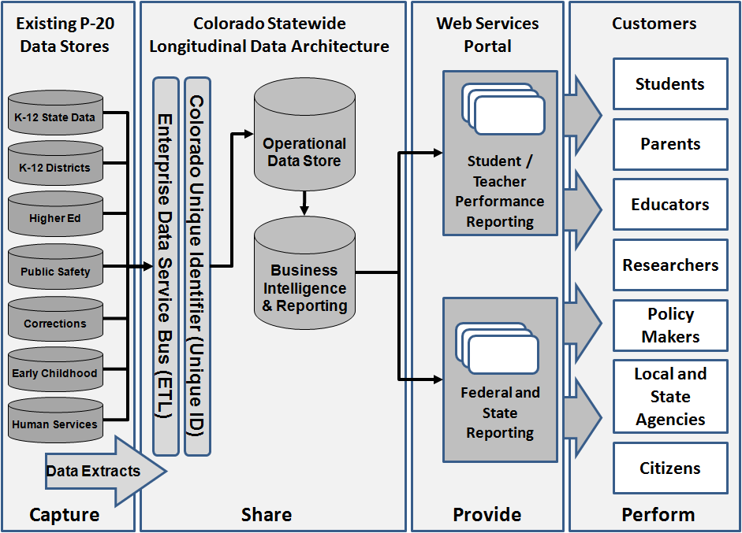
Federated Architecture
Notes:
The primary data source for the data warehouse is the CSAP scores. Students take CSAP tests once per year in the second half of the school year. CSAP scores are maintained by the Colorado Department of Education independent of usage in SchoolView. School districts provide data for student grades and demographic attributes. Colorado has 178 school districts so the number of data sources provided by school districts is large. This slide shows other data sources provided by higher education, public safety, corrections, early childhood development, and human services.

Slide 9
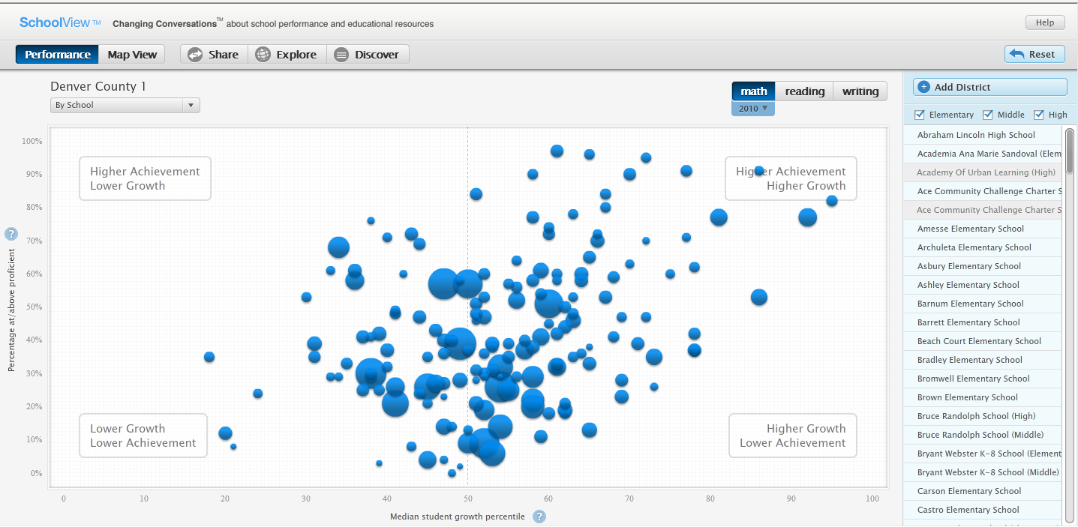
SchoolView Portal
Notes:
Colorado SchoolViewTM (www.schoolview.org) is a public portal that uses the Education Data Warehouse. SchoolView supports visual analysis of student growth on achievement tests for all Colorado school districts. Users can compare median student growth in reading, writing, and math by school as depicted in this snapshot. In addition, users can search on the dimensions of student group, grade, and ethnicity as well as rolling up to school districts. The public part of SchoolView serves parents and the public. Educators and government agencies have access to the private part of SchoolView.

Slide 10
School Entities and Facts
Standardized test results (scale points, number of points, percentage points, performance level), Growth percentile
District
Subject
School
Student demographics
Grade
Date/Time
Accommodation
Notes:
The Education Data Warehouse maintains data about important education entities and historical facts related to standardized test scores and student growth in testing performance. This diagram provides a simplified representation of major types of education entities and historical facts in the Education Data Warehouse. For student demographics, the Education Data Warehouse maintains gender, ethnicity, location characteristics, and languages spoken. For accommodations, the Education Data Warehouse maintains status of disability, English proficiency, and homelessness. For standardized test result, the Education Data Warehouse maintains four variables.

Slide 11
Summary
Prominent examples of data warehouses in retail and education
Retail dominated by large firms with distributed stores and multiple sales channels
Education dominated by highly decentralized school districts and standards imposed by higher levels of government
High level of maturity in both areas
Notes:
Diaper-beer syndrome
Folklore of data warehouse usage for business intelligence
Unexpected correlation realized using a retail DW: sales of beer and diapers by young fathers on Friday evenings (5 to 7PM)
Beer and diapers were relocated together in the front of stores with increasing sales realized.
Duly cited in hundreds of articles
Shred of truth: correlation found by consultant in 1992 for Osco Drugs. Recounted tale in a speech. Became a legend. No product placement changes made by Osco Drugs. No report of increased sales.

